Slide 1
Chapter 9
High Level Language

Slide 2
Usage Notice
You are welcome to use this presentation, or any part of it, in Nand to Tetris courses, or in other courses, as you see fit.
Usage is free provided that it supports instruction in an educational, non-profit setting.
Feel free to use the slides as-is, or modify them as needed.
We’ll appreciate it if you will give credit somewhere to Nand to Tetris, and put a reference to www.nand2tetris.org
You are welcome to remove this slide from the presentation. If you make extensive changes to the slides, you can remove the copyright notice also.
Happy teaching!
Noam Nisam / Shimon Schocken

Slide 3

Road map
write a program
Human
Thought
abstraction
p9
high-level language
compiler
abstraction
VM translator
OS
p10
VM Code
abstraction
p12
p11
p7
p8
machine language
Agenda
Projects 7,8: developing a VM translator
Projects 10,11: developing a Jack compiler
Module 12: developing an operating system
Project 9: Jack overview

Slide 4

Road map
write a program
Human
Thought
abstraction
p9
high-level language
compiler
abstraction
VM translator
OS
p10
VM Code
abstraction
p12
p11
p7
p8
machine language
Agenda
Projects 7,8: developing a VM translator
Projects 10,11: developing a Jack compiler
Module 12: developing an operating system
Project 9: Jack overview

Slide 5
Road map
write a program
Human
Thought
abstraction
p9
high-level language
compiler
abstraction
VM translator
OS
p10
VM Code
abstraction
p12
p11
p7
p8
machine language
Agenda
Projects 7,8: developing a VM translator
Projects 10,11: developing a Jack compiler
Module 12: developing an operating system
Project 9: Jack overview

Slide 6
Jack in a nutshell (using an example we saw before)
/** Demo: working with Point objects. */
class Main {
function void main() {
var Point p1, p2, p3;
let p1 = Point.new(1,2);
let p2 = Point.new(3,4);
let p3 = p1.plus(p2);
do p3.print();
do Output.println();
do Output.printInt(p1.distance(p3));
return;
}
}
A simple, Java-like language
Object-based, no inheritance
Multi-purpose
Lends itself to interactive apps
Can be learned in about an hour
/** Represents a Point object. */
class Point {
field int x, y;
static int pointCount;
/** Constructs a new point */
constructor Point new(int ax, int ay) {
let x = ax;
let y = ay;
let pointCount = pointCount + 1;
return this;
}
// More Point methods...
}

Slide 7
Take home lessons
An inside view of how high-level OO languages ...
are designed
handle primitive types and class types
create, represent, and dispose objects
deal with strings, arrays, and lists
interact with the host OS
... and many more issues
Additional experience with ...
abstrtaction – implementation
OO programming
application design and implementation.

Slide 8
High level language: lecture plan
High level programming
Hello world
Procedural programming
Object-based programming
List processing
Application development
Jack applications
Using the OS
Application example
Graphics optimization
Jack language specification
Syntax
Data types
Classes
Methods

Slide 9

Hello world
/** Hello World program. */
class Main {
function void main() {
/* Prints some text using the standard library. */
do Output.printString(”Hello world!”);
do Output.println(); // New line
return;
}
}
How many numbers? 3
Enter a number: 12
Enter a number: 8
Enter a number: 5
The average is 8
Hello world!
Fraction API

Slide 10
Language constructs
/** Hello World program. */
class Main {
function void main() {
/* Prints some text using the standard library. */
do Output.printString(”Hello world!”);
do Output.println(); // New line
return;
}
}
Comments:
/** API block comment */
/* block comment */
// in-line comment
White space
(ignored)
How many numbers? 3
Enter a number: 12
Enter a number: 8
Enter a number: 5
The average is 8

Slide 11
Procedural processing
Jack code
// Inputs some numbers and computes their average
class Main {
function void main() {
How many numbers? 3
Enter a number: 12
Enter a number: 8
Enter a number: 5
The average is 8
Fraction API

Slide 12
Procedural processing
Jack code
// Inputs some numbers and computes their average
class Main {
function void main() {
var Array a;
var int length;
var int i, sum;
let length = Keyboard.readInt(”How many numbers? ”);
let a = Array.new(length); // constructs the array
let i = 0;
while (i < length) {
let a[i] = Keyboard.readInt(”Enter a number: ”);
let sum = sum + a[i];
let i = i + 1;
}
do Output.printString(”The average is ”);
do Output.printInt(sum / length);
return;
}
}
How many numbers? 3
Enter a number: 12
Enter a number: 8
Enter a number: 5
The average is 8
Fraction API

Slide 13
Language constructs
Jack code
// Inputs some numbers and computes their average
class Main {
function void main() {
var Array a;
var int length;
var int i, sum;
let length = Keyboard.readInt(”How many numbers? ”);
let a = Array.new(length); // constructs the array
let i = 0;
while (i < length) {
let a[i] = Keyboard.readInt(”Enter a number: ”);
let sum = sum + a[i];
let i = i + 1;
}
do Output.printString(”The average is ”);
do Output.printInt(sum / length);
return;
}
}
A Jack program is a collection of one or more Jack classes, one of which must be named Main
The Main class must have at least one function, named main
Program’s entry point: Main.main

Slide 14
Language constructs
Jack code
// Inputs some numbers and computes their average
class Main {
function void main() {
var Array a;
var int length;
var int i, sum;
let length = Keyboard.readInt(”How many numbers? ”);
let a = Array.new(length); // constructs the array
let i = 0;
while (i < length) {
let a[i] = Keyboard.readInt(”Enter a number: ”);
let sum = sum + a[i];
let i = i + 1;
}
do Output.printString(”The average is ”);
do Output.printInt(sum / length);
return;
}
}
Jack data types:
Primitive:
int
char
boolean
Class types:
OS: Array, String, ...
Additional ADT’s can be defined and used, as needed

Slide 15
Language constructs
Jack code
// Inputs some numbers and computes their average
class Main {
function void main() {
var Array a;
var int length;
var int i, sum;
let length = Keyboard.readInt(”How many numbers? ”);
let a = Array.new(length); // constructs the array
let i = 0;
while (i < length) {
let a[i] = Keyboard.readInt(”Enter a number: ”);
let sum = sum + a[i];
let i = i + 1;
}
do Output.printString(”The average is ”);
do Output.printInt(sum / length);
return;
}
}
Flow of control:
if / if...else
while
do

Slide 16
Language constructs
Jack code
// Inputs some numbers and computes their average
class Main {
function void main() {
var Array a;
var int length;
var int i, sum;
let length = Keyboard.readInt(”How many numbers? ”);
let a = Array.new(length); // constructs the array
let i = 0;
while (i < length) {
let a[i] = Keyboard.readInt(”Enter a number: ”);
let sum = sum + a[i];
let i = i + 1;
}
do Output.printString(”The average is ”);
do Output.printInt(sum / length);
return;
}
}
Arrays:
Array is implemented as part of the standard class library
Jack arrays are not typed

Slide 17
Language constructs
Jack code
// Inputs some numbers and computes their average
class Main {
function void main() {
var Array a;
var int length;
var int i, sum;
let length = Keyboard.readInt(”How many numbers? ”);
let a = Array.new(length); // constructs the array
let i = 0;
while (i < length) {
let a[i] = Keyboard.readInt(”Enter a number: ”);
let sum = sum + a[i];
let i = i + 1;
}
do Output.printString(”The average is ”);
do Output.printInt(sum / length);
return;
}
}
OS services:
Keyboard.readInt
Output.printString
Output.printInt
More...

Slide 18
High level language: lecture plan
High level programming
Hello world
Procedural programming
Object-based programming
List processing
Application development
Jack applications
Using the OS
Application example
Graphics optimization
Jack language specification
Syntax
Data types
Classes
Methods

Slide 19
OO programming
Fraction API
Example: fractions
class Fraction {
/** Constructs a (reduced) fraction from the given numerator and denominator */
constructor Fraction new(int x, int y)
/** Accessors. */
method int getNumerator()
method int getDenominator()
/** Returns the sum of this fraction and the other one. */
method Fraction plus(Fraction other)
/** Disposes this fraction. */
method void dispose()
/** Prints this fraction in the format x/y. */
method void print()
}
2/3 + 1/5
(2/7 * 3/4) + 1/2
8/9 / (5/6 – 2/19)

Slide 20
OO programming: using a class
Fraction API
class Fraction {
/** Constructs a (reduced) fraction from the given numerator and denominator */
constructor Fraction new(int x, int y)
/** Accessors. */
method int getNumerator()
method int getDenominator()
/** Returns the sum of this fraction and the other one. */
method Fraction plus(Fraction other)
/** Disposes this fraction. */
method void dispose()
/** Prints this fraction in the format x/y. */
method void print()
}
13/15
Jack class
// Computes the sum of 2/3 and 1/5.
class Main {
function void main() {

Slide 21
OO programming: using a class
Fraction API
class Fraction {
/** Constructs a (reduced) fraction from the given numerator and denominator */
constructor Fraction new(int x, int y)
/** Accessors. */
method int getNumerator()
method int getDenominator()
/** Returns the sum of this fraction and the other one. */
method Fraction plus(Fraction other)
/** Disposes this fraction. */
method void dispose()
/** Prints this fraction in the format x/y. */
method void print()
}
13/15
Fraction API
Jack class
// Computes the sum of 2/3 and 1/5.
class Main {
function void main() {
var Fraction a, b, c;
let a = Fraction.new(2,3);
let b = Fraction.new(1,5);
let c = a.plus(b);
do c.print();
return;
}
}
Abstraction – implementation
Users of an abstraction need know nothing about its implementation
All they need is the class interface (API)

Slide 22
OO programming: building a class
Fraction class
/** Represents the Fraction type and related operations. */
class Fraction {

Slide 23
OO programming: building a class
Fraction class
/** Represents the Fraction type and related operations. */
class Fraction {
field int numerator, denominator;
/** Accessors. */
method int getNumerator() {
return numerator;
}
method int getDenominator() {
return denominator;
}
// More Fraction methods follow.
} // Fraction class
field, aka property, aka member variable
the only way to access field values from outside the class is through accessors
Some Jack class
class Foo {
...
var Fraction x;
let x = Fraction.new(5,17);

Slide 24
OO programming: building a class
Fraction class
/** Represents the Fraction type and related operations. */
class Fraction {
field int numerator, denominator;
/** Accessors. */
method int getNumerator() {
return numerator;
}
method int getDenominator() {
return denominator;
}
// More Fraction methods follow.
} // Fraction class
field, aka property, aka member variable
the only way to access field values from outside the class is through accessors
Some Jack class
class Foo {
...
var Fraction x;
let x = Fraction.new(5,17);
do Output.printInt(x.numerator); // not allowed
do Output.printInt(x.getNumerator()); // ok
...

Slide 25
OO programming: building a class
Fraction class
/** Represents the Fraction type and related operations. */
class Fraction {
field int numerator, denominator;
/** Constructs a (reduced) fraction from the given numerator and denominator. */
constructor Fraction new(int x, int y) {
let numerator = x; let denominator = y;
do reduce(); // reduces the fraction
return this; // returns the base address of the new object
}
// Reduces this fraction.
method void reduce() {
var int g;
let g = Fraction.gcd(numerator, denominator);
if (g > 1) {let numerator = numerator / g; let denominator = denominator / g;}
return;
}
// Computes the greatest common divisor of the given integers.
function int gcd(int a, int b) {
var int r;
while (~(b = 0)) { // applies Euclid’s algorithm.
let r = a – (b * (a / b)); // r = remainder of the integer division a/b
let a = b; let b = r; }
return a;
}
} // More Fraction code in next slide
Jack subroutines:
methods
constructors
functions
this: a reference to the current object (base address)
a constructor must return the (base address of) the newly created object
a subroutine must terminate with a return command

Slide 26
OO programming: building a class
Fraction class
/** Represents the Fraction type and related operations. */
class Fraction {
field int numerator, denominator;
/** Returns the sum of this fraction and the other one. */
method Fraction plus(Fraction other) {
var int sumNumerators;
let sumNumerators = (numerator * other.getDenominator()) +
(other.getNumerator() * denominator);
return Fraction.new(sumNumerators, denominator * other.getDenominator());
}
// More Fraction methods follow.
} // Fraction class

Slide 27
OO programming: building a class
Fraction class
/** Represents the Fraction type and related operations. */
class Fraction {
field int numerator, denominator;
/** Prints this fraction in the format x/y. */
method void print() {
do Output.printInt(numerator); do Output.printString(”/”);
do Output.printInt(denominator);
return;
}
// More Fraction methods follow.
} // Fraction class
13/15
Fraction API

Slide 28
OO programming: building a class
Fraction class
/** Represents the Fraction type and related operations. */
class Fraction {
field int numerator, denominator;

Slide 29
OO programming: building a class
Fraction class
/** Represents the Fraction type and related operations. */
class Fraction {
field int numerator, denominator;
/** Disposes this fraction. */
method void dispose() {
do Memory.deAlloc(this); // uses an OS routine to recycle the object’s memory.
return;
}
} // Fraction class
Garbage collection
Jack has no garbage collection
Objects must be disposed explicitly
Best practice: every class that has a constructor should also feature a dispose method.

Slide 30
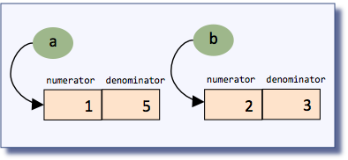
OO programming: object representation
Fraction class
RAM
/** Represents the Fraction type and related operations. */
class Fraction {
field int numerator, denominator;
/** Constructs a (reduced) fraction from the given numerator and denominator */
constructor Fraction new(int x, int y) {
let numerator = x; let denominator = y;
do reduce();
return this;
}
// More Fraction methods
}
. . .
256
. . .
15087
a
stack
4112
b
. . .
The compiled constructor’s code includes OS calls that allocate and manage RAM space for representing the new object
2047
2048
. . .
Issues:
allocating memory
de-allocating memory
(handled by the compiler and the OS)
4112
1
Client code
4113
5
. . .
heap
...
var Fraction a, b, c;
...
let a = Fraction.new(2,3);
let b = Fraction.new(1,5);
...
15087
2
The client’s view
15088
3
. . .
16383
. . .
2
3
1
5

Slide 31
OO programming: object representation
RAM
. . .
256
. . .
15087
a
stack
4112
b
. . .
2047
Implementation
2048
. . .
4112
1
4113
5
Abstraction
. . .
heap
15087
2
15088
3
. . .
16383
. . .
2
3
1
5

Slide 32
High level language: lecture plan
High level programming
Hello world
Procedural programming
Object-based programming
List processing
Application development
Jack applications
Using the OS
Application example
Graphics optimization
Jack language specification
Syntax
Data types
Classes
Methods

Slide 33
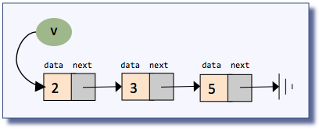
List processing
List definition
the atom null, or
an atom, followed by a list
Examples:
null
(5, null)
(3, (5, null))
(2, (3, (5, null)))
Abbreviated as:
()
(5)
(3, 5)
(2, 3, 5)
List example
The list (2, (3, (5, null))), commonly abbreviated as (2, 3, 5)

Slide 34
List processing
List API (partial)
/** Represents a linked list of integers. */
class List {
/** Creates a List */
constructor List new(int car, List cdr)
/** Prints this list */
method void print() {
/** Disposes this list */
method void dispose() {
}
// Builds, prints, and disposes a list
class Main {
function void main() {
// Creates and manipulates the list (2,(3,(5,null))), // commonly referred to as (2,3,5)
List example
The list (2, (3, (5, null))), commonly abbreviated as (2, 3, 5)

Slide 35
List processing
List API (partial)
/** Represents a linked list of integers. */
class List {
/** Creates a List */
constructor List new(int car, List cdr)
/** Prints this list */
method void print() {
/** Disposes this list */
method void dispose() {
}
2 3 5
// Builds, prints, and disposes a list
class Main {
function void main() {
// Creates and manipulates the list (2,(3,(5,null))), // commonly referred to as (2,3,5)
var List v;
let v = List.new(5,null);
let v = List.new(3,v));
let v = List.new(2,v));
do v.print();
do v.dispose(); // disposes the list
return;
}
}
List example
The list (2, (3, (5, null))), commonly abbreviated as (2, 3, 5)

Slide 36
List processing: creation
List class
client code
/** Represents a linked list of integers. */
class List {
...
var List v;
let v = List.new(5,null);
let v = List.new(3, v));
let v = List.new(2, v));
...

Slide 37
List processing: creation
List class
client code
/** Represents a linked list of integers. */
class List {
field int data; // a list consists of a data field,
field List next; // followed by a list.
...
var List v;
let v = List.new(5,null);
let v = List.new(3, v));
let v = List.new(2, v));
...

Slide 38
List processing: creation
List class
client code
/** Represents a linked list of integers. */
class List {
field int data; // a list consists of a data field,
field List next; // followed by a list.
/* Creates a List. */
constructor List new(int car, List cdr) {
let data = car;
let next = cdr;
return this;
}
// More List methods
}
...
var List v;
let v = List.new(5,null);
let v = List.new(3, v));
let v = List.new(2, v));
...
v

Slide 39
List processing: creation
List class
client code
/** Represents a linked list of integers. */
class List {
field int data; // a list consists of a data field,
field List next; // followed by a list.
/* Creates a List. */
constructor List new(int car, List cdr) {
let data = car;
let next = cdr;
return this;
}
// More List methods
}
...
var List v;
let v = List.new(5,null);
let v = List.new(3, v));
let v = List.new(2, v));
...
v

Slide 40
List processing: creation
List class
client code
/** Represents a linked list of integers. */
class List {
field int data; // a list consists of a data field,
field List next; // followed by a list.
/* Creates a List. */
constructor List new(int car, List cdr) {
let data = car;
let next = cdr;
return this;
}
// More List methods
}
...
var List v;
let v = List.new(5,null);
let v = List.new(3, v));
let v = List.new(2, v));
...
v
data next
5

Slide 41
List processing: creation
List class
client code
/** Represents a linked list of integers. */
class List {
field int data; // a list consists of a data field,
field List next; // followed by a list.
/* Creates a List. */
constructor List new(int car, List cdr) {
let data = car;
let next = cdr;
return this;
}
// More List methods
}
...
var List v;
let v = List.new(5,null);
let v = List.new(3, v));
let v = List.new(2, v));
...
v
data next
5

Slide 42
List processing: creation
List class
client code
/** Represents a linked list of integers. */
class List {
field int data; // a list consists of a data field,
field List next; // followed by a list.
/* Creates a List. */
constructor List new(int car, List cdr) {
let data = car;
let next = cdr;
return this;
}
// More List methods
}
...
var List v;
let v = List.new(5,null);
let v = List.new(3, v));
let v = List.new(2, v));
...
v
v
data next
data next
3
5

Slide 43
List processing: creation
List class
client code
/** Represents a linked list of integers. */
class List {
field int data; // a list consists of a data field,
field List next; // followed by a list.
/* Creates a List. */
constructor List new(int car, List cdr) {
let data = car;
let next = cdr;
return this;
}
// More List methods
}
...
var List v;
let v = List.new(5,null);
let v = List.new(3, v));
let v = List.new(2, v));
...
v
data next
data next
3
5

Slide 44
List processing: creation
List class
client code
/** Represents a linked list of integers. */
class List {
field int data; // a list consists of a data field,
field List next; // followed by a list.
/* Creates a List. */
constructor List new(int car, List cdr) {
let data = car;
let next = cdr;
return this;
}
// More List methods
}
...
var List v;
let v = List.new(5,null);
let v = List.new(3, v));
let v = List.new(2, v));
...
v
v
data next
data next
data next
2
3
5

Slide 45
List processing: creation
List class
client code
/** Represents a linked list of integers. */
class List {
field int data; // a list consists of a data field,
field List next; // followed by a list.
/* Creates a List. */
constructor List new(int car, List cdr) {
let data = car;
let next = cdr;
return this;
}
// More List methods
}
...
var List v;
let v = List.new(5,null);
let v = List.new(3, v));
let v = List.new(2, v));
...
equivalent to:
var List v;
let v = List.new(5,null);
let v = List.new(2,List.new(3,v));
v
data next
data next
data next
2
3
5

Slide 46
List processing: sequential access
List class
/** Represents a linked list of integers. */
class List {
field int data; // a list consists of a data field,
field List next; // followed by a list.
/** Prints this list. */
method void print() {

Slide 47
List processing: sequential access
List class
client code
/** Represents a linked list of integers. */
class List {
field int data; // a list consists of a data field,
field List next; // followed by a list.
/** Prints this list. */
method void print() {
var List current; // creates a List variable and
let current = this; // initializes it to the first item of this list
while (~(current = null)) {
do Output.printInt(current.getData());
do Output.printChar(32); // prints a space
do current = current.getNext();
}
return;
}
// More list methods
}
var List v;
// builds the list (2, 3, 5)
...
do v.print();
...
v
data next data next data next
2
3
5

Slide 48
List processing: sequential access
List class
client code
/** Represents a linked list of integers. */
class List {
field int data; // a list consists of a data field,
field List next; // followed by a list.
/** Prints this list. */
method void print() {
var List current; // creates a List variable and
let current = this; // initializes it to the first item of this list
while (~(current = null)) {
do Output.printInt(current.getData());
do Output.printChar(32); // prints a space
do current = current.getNext();
}
return;
}
// More list methods
}
var List v;
// builds the list (2, 3, 5)
...
do v.print();
...
v
data next data next data next
2
3
5

Slide 49
List processing: sequential access
List class
client code
/** Represents a linked list of integers. */
class List {
field int data; // a list consists of a data field,
field List next; // followed by a list.
/** Prints this list. */
method void print() {
var List current; // creates a List variable and
let current = this; // initializes it to the first item of this list
while (~(current = null)) {
do Output.printInt(current.getData());
do Output.printChar(32); // prints a space
do current = current.getNext();
}
return;
}
// More list methods
}
var List v;
// builds the list (2, 3, 5)
...
do v.print();
...
this
data next data next data next
2
3
5

Slide 50
List processing: sequential access
List class
client code
/** Represents a linked list of integers. */
class List {
field int data; // a list consists of a data field,
field List next; // followed by a list.
/** Prints this list. */
method void print() {
var List current; // creates a List variable and
let current = this; // initializes it to the first item of this list
while (~(current = null)) {
do Output.printInt(current.getData());
do Output.printChar(32); // prints a space
do current = current.getNext();
}
return;
}
// More list methods
}
var List v;
// builds the list (2, 3, 5)
...
do v.print();
...
this
data next data next data next
2
3
5

Slide 51
List processing: sequential access
List class
client code
/** Represents a linked list of integers. */
class List {
field int data; // a list consists of a data field,
field List next; // followed by a list.
/** Prints this list. */
method void print() {
var List current; // creates a List variable and
let current = this; // initializes it to the first item of this list
while (~(current = null)) {
do Output.printInt(current.getData());
do Output.printChar(32); // prints a space
do current = current.getNext();
}
return;
}
// More list methods
}
var List v;
// builds the list (2, 3, 5)
...
do v.print();
...
this
data next data next data next
2
3
5

Slide 52
List processing: sequential access
List class
client code
/** Represents a linked list of integers. */
class List {
field int data; // a list consists of a data field,
field List next; // followed by a list.
/** Prints this list. */
method void print() {
var List current; // creates a List variable and
let current = this; // initializes it to the first item of this list
while (~(current = null)) {
do Output.printInt(current.getData());
do Output.printChar(32); // prints a space
do current = current.getNext();
}
return;
}
// More list methods
}
var List v;
// builds the list (2, 3, 5)
...
do v.print();
...
this
current
data next data next data next
2
3
5

Slide 53
List processing: sequential access
List class
client code
/** Represents a linked list of integers. */
class List {
field int data; // a list consists of a data field,
field List next; // followed by a list.
/** Prints this list. */
method void print() {
var List current; // creates a List variable and
let current = this; // initializes it to the first item of this list
while (~(current = null)) {
do Output.printInt(current.getData());
do Output.printChar(32); // prints a space
do current = current.getNext();
}
return;
}
// More list methods
}
var List v;
// builds the list (2, 3, 5)
...
do v.print();
...
this
current
data next data next data next
2
3
5

Slide 54
List processing: sequential access
List class
client code
/** Represents a linked list of integers. */
class List {
field int data; // a list consists of a data field,
field List next; // followed by a list.
/** Prints this list. */
method void print() {
var List current; // creates a List variable and
let current = this; // initializes it to the first item of this list
while (~(current = null)) {
do Output.printInt(current.getData());
do Output.printChar(32); // prints a space
do current = current.getNext();
}
return;
}
// More list methods
}
var List v;
// builds the list (2, 3, 5)
...
do v.print();
...
2
this
current
data next data next data next
2
3
5

Slide 55
List processing: sequential access
List class
client code
/** Represents a linked list of integers. */
class List {
field int data; // a list consists of a data field,
field List next; // followed by a list.
/** Prints this list. */
method void print() {
var List current; // creates a List variable and
let current = this; // initializes it to the first item of this list
while (~(current = null)) {
do Output.printInt(current.getData());
do Output.printChar(32); // prints a space
do current = current.getNext();
}
return;
}
// More list methods
}
var List v;
// builds the list (2, 3, 5)
...
do v.print();
...
2
this
current
data next data next data next
2
3
5

Slide 56
List processing: sequential access
List class
client code
/** Represents a linked list of integers. */
class List {
field int data; // a list consists of a data field,
field List next; // followed by a list.
/** Prints this list. */
method void print() {
var List current; // creates a List variable and
let current = this; // initializes it to the first item of this list
while (~(current = null)) {
do Output.printInt(current.getData());
do Output.printChar(32); // prints a space
do current = current.getNext();
}
return;
}
// More list methods
}
var List v;
// builds the list (2, 3, 5)
...
do v.print();
...
2 3
this
current
data next data next data next
2
3
5

Slide 57
List processing: sequential access
List class
client code
/** Represents a linked list of integers. */
class List {
field int data; // a list consists of a data field,
field List next; // followed by a list.
/** Prints this list. */
method void print() {
var List current; // creates a List variable and
let current = this; // initializes it to the first item of this list
while (~(current = null)) {
do Output.printInt(current.getData());
do Output.printChar(32); // prints a space
do current = current.getNext();
}
return;
}
// More list methods
}
var List v;
// builds the list (2, 3, 5)
...
do v.print();
...
2 3
this
current
data next data next data next
2
3
5

Slide 58
List processing: sequential access
List class
client code
/** Represents a linked list of integers. */
class List {
field int data; // a list consists of a data field,
field List next; // followed by a list.
/** Prints this list. */
method void print() {
var List current; // creates a List variable and
let current = this; // initializes it to the first item of this list
while (~(current = null)) {
do Output.printInt(current.getData());
do Output.printChar(32); // prints a space
do current = current.getNext();
}
return;
}
// More list methods
}
var List v;
// builds the list (2, 3, 5)
...
do v.print();
...
2 3 5
this
current
data next data next data next
2
3
5

Slide 59
List processing: sequential access
List class
client code
/** Represents a linked list of integers. */
class List {
field int data; // a list consists of a data field,
field List next; // followed by a list.
/** Prints this list. */
method void print() {
var List current; // creates a List variable and
let current = this; // initializes it to the first item of this list
while (~(current = null)) {
do Output.printInt(current.getData());
do Output.printChar(32); // prints a space
do current = current.getNext();
}
return;
}
// More list methods
}
var List v;
// builds the list (2, 3, 5)
...
do v.print();
...
2 3 5
this
current
data next data next data next
2
3
5

Slide 60
List processing: sequential access
List class
client code
/** Represents a linked list of integers. */
class List {
field int data; // a list consists of a data field,
field List next; // followed by a list.
/** Prints this list. */
method void print() {
var List current; // creates a List variable and
let current = this; // initializes it to the first item of this list
while (~(current = null)) {
do Output.printInt(current.getData());
do Output.printChar(32); // prints a space
do current = current.getNext();
}
return;
}
// More list methods
}
var List v;
// builds the list (2, 3, 5)
...
do v.print();
...
2 3 5
this
current
data next data next data next
2
3
5

Slide 61
List processing: sequential access
List class
client code
/** Represents a linked list of integers. */
class List {
field int data; // a list consists of a data field,
field List next; // followed by a list.
/** Prints this list. */
method void print() {
var List current; // creates a List variable and
let current = this; // initializes it to the first item of this list
while (~(current = null)) {
do Output.printInt(current.getData());
do Output.printChar(32); // prints a space
do current = current.getNext();
}
return;
}
// More list methods
}
var List v;
// builds the list (2, 3, 5)
...
do v.print();
...
2 3 5
this
current
data next data next data next
2
3
5

Slide 62
List processing: sequential access
List class
client code
/** Represents a linked list of integers. */
class List {
field int data; // a list consists of a data field,
field List next; // followed by a list.
/** Prints this list. */
method void print() {
var List current; // creates a List variable and
let current = this; // initializes it to the first item of this list
while (~(current = null)) {
do Output.printInt(current.getData());
do Output.printChar(32); // prints a space
do current = current.getNext();
}
return;
}
// More list methods
}
var List v;
// builds the list (2, 3, 5)
...
do v.print();
...
2 3 5
v
data next data next data next
2
3
5

Slide 63
List processing: recursive access

Slide 64
List processing: recursive access
List class
/** Represents a linked list of integers. */
class List {
field int data; // a list consists of a data field,
field List next; // followed by a list.
/** Disposes this list */
// by recursively disposing its tail
method void dispose() {
if (~(next = null)) {
do next.dispose();
}
// Uses an OS routine to recycle this list
do Memory.deAlloc(this);
return;
}
}

Slide 65
List processing: recursive access
List class
client code
/** Represents a linked list of integers. */
class List {
field int data; // a list consists of a data field,
field List next; // followed by a list.
/** Disposes this list */
// by recursively disposing its tail
method void dispose() {
if (~(next = null)) {
do next.dispose();
}
// Uses an OS routine to recycle this list
do Memory.deAlloc(this);
return;
}
}
var List v;
// builds the list (2, 3, 5)
...
do v.dispose();
...
v
data next data next data next
2
3
5

Slide 66
List processing: recursive access
List class
client code
/** Represents a linked list of integers. */
class List {
field int data; // a list consists of a data field,
field List next; // followed by a list.
/** Disposes this list */
// by recursively disposing its tail
method void dispose() {
if (~(next = null)) {
do next.dispose();
}
// Uses an OS routine to recycle this list
do Memory.deAlloc(this);
return;
}
}
var List v;
// builds the list (2, 3, 5)
...
do v.dispose();
...
v
data next data next data next
2
3
5

Slide 67
List processing: recursive access
List class
client code
/** Represents a linked list of integers. */
class List {
field int data; // a list consists of a data field,
field List next; // followed by a list.
/** Disposes this list */
// by recursively disposing its tail
method void dispose() {
if (~(next = null)) {
do next.dispose();
}
// Uses an OS routine to recycle this list
do Memory.deAlloc(this);
return;
}
}
var List v;
// builds the list (2, 3, 5)
...
do v.dispose();
...
this
data next data next data next
2
3
5

Slide 68
List processing: recursive access
List class
client code
/** Represents a linked list of integers. */
class List {
field int data; // a list consists of a data field,
field List next; // followed by a list.
/** Disposes this list */
// by recursively disposing its tail
method void dispose() {
if (~(next = null)) {
do next.dispose();
}
// Uses an OS routine to recycle this list
do Memory.deAlloc(this);
return;
}
}
var List v;
// builds the list (2, 3, 5)
...
do v.dispose();
...
this
this
this
data next data next data next
data next data next data next
3
2
3
2
5
5

Slide 69
List processing: recursive access
List class
client code
/** Represents a linked list of integers. */
class List {
field int data; // a list consists of a data field,
field List next; // followed by a list.
/** Disposes this list */
// by recursively disposing its tail
method void dispose() {
if (~(next = null)) {
do next.dispose();
}
// Uses an OS routine to recycle this list
do Memory.deAlloc(this);
return;
}
}
var List v;
// builds the list (2, 3, 5)
...
do v.dispose();
...
this
this
data next data next data next
2
3
5

Slide 70
List processing: recursive access
List class
client code
/** Represents a linked list of integers. */
class List {
field int data; // a list consists of a data field,
field List next; // followed by a list.
/** Disposes this list */
// by recursively disposing its tail
method void dispose() {
if (~(next = null)) {
do next.dispose();
}
// Uses an OS routine to recycle this list
do Memory.deAlloc(this);
return;
}
}
var List v;
// builds the list (2, 3, 5)
...
do v.dispose();
...
this
this
this
data next data next data next
2
3
5

Slide 71
List processing: recursive access
List class
client code
/** Represents a linked list of integers. */
class List {
field int data; // a list consists of a data field,
field List next; // followed by a list.
/** Disposes this list */
// by recursively disposing its tail
method void dispose() {
if (~(next = null)) {
do next.dispose();
}
// Uses an OS routine to recycle this list
do Memory.deAlloc(this);
return;
}
}
var List v;
// builds the list (2, 3, 5)
...
do v.dispose();
...
this
this
this
data next data next data next
2
3
5

Slide 72

List processing: recursive access
List class
client code
/** Represents a linked list of integers. */
class List {
field int data; // a list consists of a data field,
field List next; // followed by a list.
/** Disposes this list */
// by recursively disposing its tail
method void dispose() {
if (~(next = null)) {
do next.dispose();
}
// Uses an OS routine to recycle this list
do Memory.deAlloc(this);
return;
}
}
var List v;
// builds the list (2, 3, 5)
...
do v.dispose();
...
this
this
this
data next data next data next
2
3
5

Slide 73
List processing: recursive access
List class
client code
/** Represents a linked list of integers. */
class List {
field int data; // a list consists of a data field,
field List next; // followed by a list.
/** Disposes this list */
// by recursively disposing its tail
method void dispose() {
if (~(next = null)) {
do next.dispose();
}
// Uses an OS routine to recycle this list
do Memory.deAlloc(this);
return;
}
}
var List v;
// builds the list (2, 3, 5)
...
do v.dispose();
...
this
this
data next data next
2
3

Slide 74
List processing: recursive access
List class
client code
/** Represents a linked list of integers. */
class List {
field int data; // a list consists of a data field,
field List next; // followed by a list.
/** Disposes this list */
// by recursively disposing its tail
method void dispose() {
if (~(next = null)) {
do next.dispose();
}
// Uses an OS routine to recycle this list
do Memory.deAlloc(this);
return;
}
}
var List v;
// builds the list (2, 3, 5)
...
do v.dispose();
...
this
this
data next data next
2
3

Slide 75
List processing: recursive access
List class
client code
/** Represents a linked list of integers. */
class List {
field int data; // a list consists of a data field,
field List next; // followed by a list.
/** Disposes this list */
// by recursively disposing its tail
method void dispose() {
if (~(next = null)) {
do next.dispose();
}
// Uses an OS routine to recycle this list
do Memory.deAlloc(this);
return;
}
}
var List v;
// builds the list (2, 3, 5)
...
do v.dispose();
...
this
data next
2

Slide 76
List processing: recursive access
List class
client code
/** Represents a linked list of integers. */
class List {
field int data; // a list consists of a data field,
field List next; // followed by a list.
/** Disposes this list */
// by recursively disposing its tail
method void dispose() {
if (~(next = null)) {
do next.dispose();
}
// Uses an OS routine to recycle this list
do Memory.deAlloc(this);
return;
}
}
var List v;
// builds the list (2, 3, 5)
...
do v.dispose();
...
this
data next
2

Slide 77
List processing: recursive access
List class
client code
/** Represents a linked list of integers. */
class List {
field int data; // a list consists of a data field,
field List next; // followed by a list.
/** Disposes this list */
// by recursively disposing its tail
method void dispose() {
if (~(next = null)) {
do next.dispose();
}
// Uses an OS routine to recycle this list
do Memory.deAlloc(this);
return;
}
}
var List v;
// builds the list (2, 3, 5)
...
do v.dispose();
...
this

Slide 78
List processing: recursive access
List class
client code
/** Represents a linked list of integers. */
class List {
field int data; // a list consists of a data field,
field List next; // followed by a list.
/** Disposes this list */
// by recursively disposing its tail
method void dispose() {
if (~(next = null)) {
do next.dispose();
}
// Uses an OS routine to recycle this list
do Memory.deAlloc(this);
return;
}
}
var List v;
// builds the list (2, 3, 5)
...
do v.dispose();
...
this

Slide 79
List processing: recursive access
List class
client code
/** Represents a linked list of integers. */
class List {
field int data; // a list consists of a data field,
field List next; // followed by a list.
/** Disposes this list */
// by recursively disposing its tail
method void dispose() {
if (~(next = null)) {
do next.dispose();
}
// Uses an OS routine to recycle this list
do Memory.deAlloc(this);
return;
}
}
var List v;
// builds the list (2, 3, 5)
...
do v.dispose();
...
v

Slide 80
Recap
We saw examples of:
Building a list
Processing a list, sequentially
Processing a list, recursively
Disposing a list
v
data next data next data next
2
3
5
Who and what makes the magic work?
When an object is constructed or disposed, the OS is responsible for allocating and reclaiming, respectively, the necessary RAM space
List processing is implemented by pointer manipulation
The pointer manipulation is done by the code that is generated by the compiler.

Slide 81
High level language: lecture plan
High level programming
Hello world
Procedural programming
Object-based programming
List processing
Application development
Jack applications
Using the OS
Application example
Graphics optimization
Jack language specification
Syntax
Data types
Classes
Methods

Slide 82
Syntax
/** Procedural processing example */
class Main {
/* Inputs some numbers and computes their average */
function void main() {
var Array a;
var int length;
var int i, sum;
let length = Keyboard.readInt(”How many numbers? ”);
let a = Array.new(length); // constructs the array
let i = 0;
while (i < length) {
let a[i] = Keyboard.readInt(”Enter a number: ”);
let sum = sum + a[i];
let i = i + 1;
}
...
}
Syntax elements:
White space / comments
keywords
Symbols
Constants
Identifiers

Slide 83
Syntax: white space / comments
/** Procedural processing example */
class Main {
/* Inputs some numbers and computes their average */
function void main() {
var Array a;
var int length;
var int i, sum;
let length = Keyboard.readInt(”How many numbers? ”);
let a = Array.new(length); // constructs the array
let i = 0;
while (i < length) {
let a[i] = Keyboard.readInt(”Enter a number: ”);
let sum = sum + a[i];
let i = i + 1;
}
...
}
Syntax elements:
White space / comments
keywords
Symbols
Constants
Identifiers

Slide 84
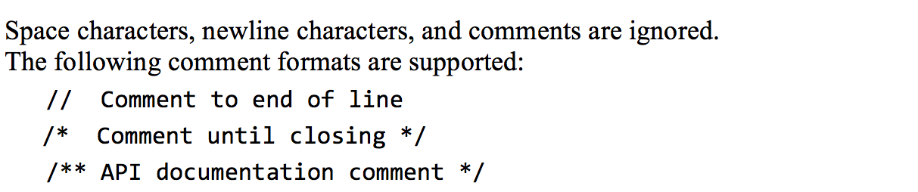
Syntax: white space / comments
/** Procedural processing example */
class Main {
/* Inputs some numbers and computes their average */
function void main() {
var Array a;
var int length;
var int i, sum;
let length = Keyboard.readInt(”How many numbers? ”);
let a = Array.new(length); // constructs the array
let i = 0;
while (i < length) {
let a[i] = Keyboard.readInt(”Enter a number: ”);
let sum = sum + a[i];
let i = i + 1;
}
...
}
Syntax elements:
White space / comments
keywords
Symbols
Constants
Identifiers

Slide 85
Syntax: keywords
/** Procedural processing example */
class Main {
/* Inputs some numbers and computes their average */
function void main() {
var Array a;
var int length;
var int i, sum;
let length = Keyboard.readInt(”How many numbers? ”);
let a = Array.new(length); // constructs the array
let i = 0;
while (i < length) {
let a[i] = Keyboard.readInt(”Enter a number: ”);
let sum = sum + a[i];
let i = i + 1;
}
...
}
Syntax elements:
White space / comments
keywords
Symbols
Constants
Identifiers

Slide 86
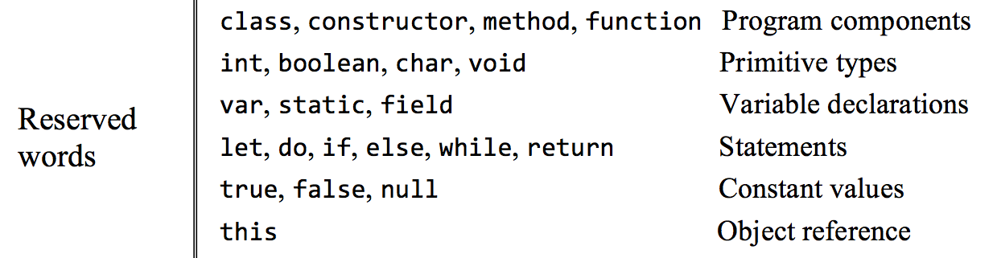
Syntax: keywords
/** Procedural processing example */
class Main {
/* Inputs some numbers and computes their average */
function void main() {
var Array a;
var int length;
var int i, sum;
let length = Keyboard.readInt(”How many numbers? ”);
let a = Array.new(length); // constructs the array
let i = 0;
while (i < length) {
let a[i] = Keyboard.readInt(”Enter a number: ”);
let sum = sum + a[i];
let i = i + 1;
}
...
}
Syntax elements:
White space / comments
keywords
Symbols
Constants
Identifiers

Slide 87
Syntax: symbols
/** Procedural processing example */
class Main {
/* Inputs some numbers and computes their average */
function void main() {
var Array a;
var int length;
var int i, sum;
let length = Keyboard.readInt(”How many numbers? ”);
let a = Array.new(length); // constructs the array
let i = 0;
while (i < length) {
let a[i] = Keyboard.readInt(”Enter a number: ”);
let sum = sum + a[i];
let i = i + 1;
}
...
}
Syntax elements:
White space / comments
keywords
Symbols
Constants
Identifiers

Slide 88
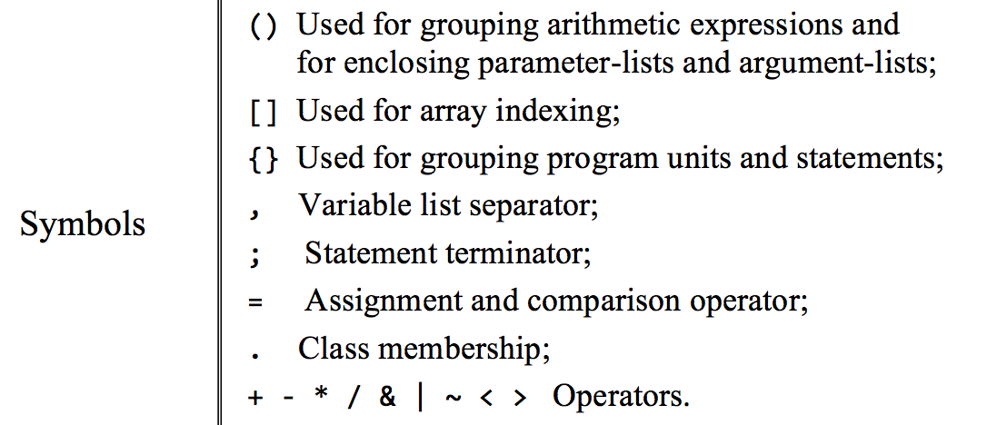
Syntax: symbols
/** Procedural processing example */
class Main {
/* Inputs some numbers and computes their average */
function void main() {
var Array a;
var int length;
var int i, sum;
let length = Keyboard.readInt(”How many numbers? ”);
let a = Array.new(length); // constructs the array
let i = 0;
while (i < length) {
let a[i] = Keyboard.readInt(”Enter a number: ”);
let sum = sum + a[i];
let i = i + 1;
}
...
}
Syntax elements:
White space / comments
keywords
Symbols
Constants
Identifiers

Slide 89
Syntax: constants
/** Procedural processing example */
class Main {
/* Inputs some numbers and computes their average */
function void main() {
var Array a;
var int length;
var int i, sum;
let length = Keyboard.readInt(”How many numbers? ”);
let a = Array.new(length); // constructs the array
let i = 0;
while (i < length) {
let a[i] = Keyboard.readInt(”Enter a number: ”);
let sum = sum + a[i];
let i = i + 1;
}
...
}
Syntax elements:
White space / comments
keywords
Symbols
Constants
Identifiers

Slide 90
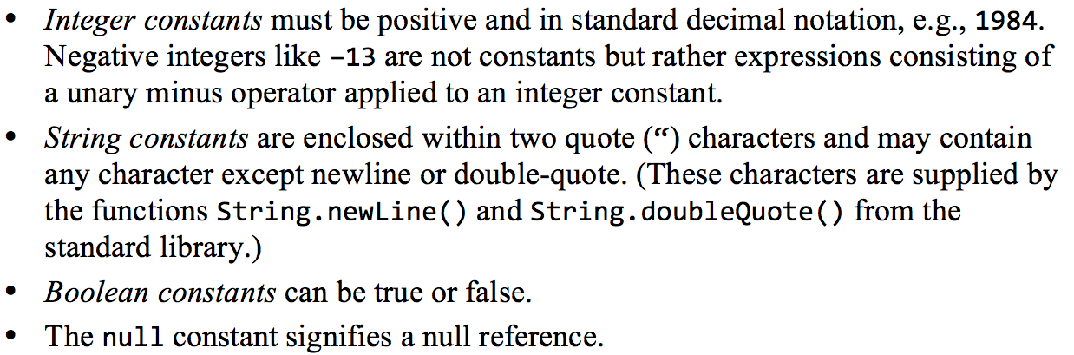
Syntax: constants
/** Procedural processing example */
class Main {
/* Inputs some numbers and computes their average */
function void main() {
var Array a;
var int length;
var int i, sum;
let length = Keyboard.readInt(”How many numbers? ”);
let a = Array.new(length); // constructs the array
let i = 0;
while (i < length) {
let a[i] = Keyboard.readInt(”Enter a number: ”);
let sum = sum + a[i];
let i = i + 1;
}
...
}
Syntax elements:
White space / comments
keywords
Symbols
Constants
Identifiers

Slide 91
Syntax: identifiers
/** Procedural processing example */
class Main {
/* Inputs some numbers and computes their average */
function void main() {
var Array a;
var int length;
var int i, sum;
let length = Keyboard.readInt(”How many numbers? ”);
let a = Array.new(length); // constructs the array
let i = 0;
while (i < length) {
let a[i] = Keyboard.readInt(”Enter a number: ”);
let sum = sum + a[i];
let i = i + 1;
}
...
}
Syntax elements:
White space / comments
keywords
Symbols
Constants
Identifiers

Slide 92
Syntax: identifiers
/** Procedural processing example */
class Main {
/* Inputs some numbers and computes their average */
function void main() {
var Array a;
var int length;
var int i, sum;
let length = Keyboard.readInt(”How many numbers? ”);
let a = Array.new(length); // constructs the array
let i = 0;
while (i < length) {
let a[i] = Keyboard.readInt(”Enter a number: ”);
let sum = sum + a[i];
let i = i + 1;
}
...
}
Syntax elements:
White space / comments
keywords
Symbols
Constants
Identifiers

Slide 93
Recap
/** Procedural processing example */
class Main {
/* Inputs some numbers and computes their average */
function void main() {
var Array a;
var int length;
var int i, sum;
let length = Keyboard.readInt(”How many numbers? ”);
let a = Array.new(length); // constructs the array
let i = 0;
while (i < length) {
let a[i] = Keyboard.readInt(”Enter a number: ”);
let sum = sum + a[i];
let i = i + 1;
}
...
}
Syntax elements:
White space / comments
keywords
Symbols
Constants
Identifiers

Slide 94
High level language: lecture plan
High level programming
Hello world
Procedural programming
Object-based programming
List processing
Application development
Jack applications
Using the OS
Application example
Graphics optimization
Jack language specification
Syntax
Data types
Classes
Methods

Slide 95
Data types
/** Procedural processing example */
class Main {
/* Inputs some numbers and computes their average */
function void main() {
var Array a;
var int length;
var int i, sum;
let length = Keyboard.readInt(”How many numbers? ”);
let a = Array.new(length); // constructs the array
let i = 0;
while (i < length) {
let a[i] = Keyboard.readInt(”Enter a number: ”);
let sum = sum + a[i];
let i = i + 1;
}
...
}
Primitive types
int: Non-negative 2’s-complement 16-bit integer, i.e. an integer in the range 0,..., 32767
boolean: true or false
char: Integer values representing characters
Class types
OS types: String, Array
User-defined types: Fraction, List, ...

Slide 96
The Hack character set
key | code
(space) | 32
! | 33
“ | 34
# | 35
$ | 36
% | 37
& | 38
‘ | 39
( | 40
) | 41
* | 42
+ | 43
, | 44
- | 45
. | 46
/ | 47
key | code
0 | 48
1 | 49
… | …
9 | 57
key | code
A | 65
B | 66
C | …
… | …
Z | 90
key | code
a | 97
b | 98
c | 99
… | …
z | 122
key | code
newline | 128
backspace | 129
left arrow | 130
up arrow | 131
right arrow | 132
down arrow | 133
home | 134
end | 135
Page up | 136
Page down | 137
insert | 138
delete | 139
esc | 140
f1 | 141
… | …
f12 | 152
: | 58
; | 59
< | 60
= | 61
> | 62
? | 63
@ | 64
[ | 91
/ | 92
] | 93
^ | 94
_ | 95
` | 96
{ | 123
| | 124
} | 125
~ | 126

Slide 97
Type conversions
Characters and integers can be converted into each other, as needed:
var char c; var String s;

Slide 98
Type conversions
Characters and integers can be converted into each other, as needed:
var char c; var String s;
let c = 65; // 'A'
let c = 'A'; // Not supported by the Jack language
let s = "A"; let c = s.charAt(0); // 'A', ok
An integer can be assigned to a reference variables, in which case it is treated as a memory address:
var Array arr; // creates a pointer variable

Slide 99
Type conversions
Characters and integers can be converted into each other, as needed:
var char c; var String s;
let c = 65; // 'A'
let c = 'A'; // Not supported by the Jack language
let s = "A"; let c = s.charAt(0); // 'A', ok
An integer can be assigned to a reference variables, in which case it is treated as a memory address:
var Array arr; // creates a pointer variable
let arr = 5000; // ok...
let arr[100] = 17; // sets memory address 5100 to 17
An object can be converted into an Array, and vice versa:
var Array arr;
let arr = Array.new(2);
let arr[0] = 2; let arr[1] = 5;

Slide 100
Type conversions
Characters and integers can be converted into each other, as needed:
var char c; var String s;
let c = 65; // 'A'
let c = 'A'; // Not supported by the Jack language
let s = "A"; let c = s.charAt(0); // 'A', ok
An integer can be assigned to a reference variables, in which case it is treated as a memory address:
var Array arr; // creates a pointer variable
let arr = 5000; // ok...
let arr[100] = 17; // sets memory address 5100 to 17
An object can be converted into an Array, and vice versa:
var Array arr;
let arr = Array.new(2);
let arr[0] = 2; let arr[1] = 5;
var Fraction x; // a Fraction object has two int fields: numerator and denominator.
let x = arr; // sets x to the base address of the memory block representing the array [2,5]
do x.print() // prints 2/5 (using the print method of the Fraction class)

Slide 101
High level language: lecture plan
High level programming
Hello world
Procedural programming
Object-based programming
List processing
Application development
Jack applications
Using the OS
Application example
Graphics optimization
Jack language specification
Syntax
Data types
Classes
Methods

Slide 102
Classes
Class = basic compilation unit
Each class Foo is stored in a separate Foo.jack file
The class name’s first character must be an uppercase letter.
Foo.jack file
class Foo {
field variable declarations
static variable declarations
subroutine declarations
}
must precede the subroutine declarations
constructors, methods, functions

Slide 103
Utility classes
Math class API (example)
Provides various mathematical operations.
function int abs(int x): returns the absolute value of x.
function int multiply(int x, int y): returns the product of x and y.
function int divide(int x, int y): returns the integer part of x/y.
function int min(int x, int y): returns the minimum of x and y.
function int max(int x, int y): returns the maximum of x and y.
function int sqrt(int x): returns the integer part of the square root of x.
A class that contains only functions (“static methods”) can be called a “utility class”
(no fields, constructors, or methods)
Offers a “library of services”

Slide 104
Classes that represent entities (objects)
Examples: Fraction, List, String, ...
A class that contains at least one method
Used to represent an object type and operations on this object
Typically contains fields and methods
Can also contain functions, recommended for “helper” purpose only
Best practice:
Don’t mix library functionality and object representation in the same class.

Slide 105
Typical bad example....
Fraction class
/** Represents the Fraction type and related operations. */
class Fraction {
field int numerator, denominator;
/** Constructs a (reduced) fraction from the given numerator and denominator. */
constructor Fraction new(int x, int y) {
let numerator = x; let denominator = y;
do reduce(); // reduces the fraction
return this; // returns the base address of the new object
}
// Reduces this fraction.
method void reduce() {
var int g;
let g = Fraction.gcd(numerator, denominator);
if (g > 1) {let numerator = numerator / g; let denominator = denominator / g;}
return;
}
// Computes the greatest common divisor of the given integers.
function int gcd(int a, int b) {
var int r;
while (~(b = 0)) { // applies Euclid’s algorithm.
let r = a – (b * (a / b)); // r = remainder of the integer division a/b
let a = b; let b = r; }
return a;
}
// More Fraction methods

Slide 106
Typical bad example....
Fraction class
/** Represents the Fraction type and related operations. */
class Fraction {
field int numerator, denominator;
/** Constructs a (reduced) fraction from the given numerator and denominator. */
constructor Fraction new(int x, int y) {
let numerator = x; let denominator = y;
do reduce(); // reduces the fraction
return this; // returns the base address of the new object
}
// Reduces this fraction.
method void reduce() {
var int g;
let g = Fraction.gcd(numerator, denominator);
if (g > 1) {let numerator = numerator / g; let denominator = denominator / g;}
return;
}
// Computes the greatest common divisor of the given integers.
function int gcd(int a, int b) {
var int r;
while (~(b = 0)) { // applies Euclid’s algorithm.
let r = a – (b * (a / b)); // r = remainder of the integer division a/b
let a = b; let b = r; }
return a;
}
// More Fraction methods

Slide 107
After refactoring:
/** A library of math functions. */
class Math {
...
// Computes the greatest common divisor of the given integers.
function int gcd(int a, int b) {
var int r;
while (~(b = 0)) {
let r = a – (b * (a / b));
let a = b; let b = r; }
return a;
}
...
} // More Math function
Fraction class
/** Represents the Fraction type and related operations. */
class Fraction {
field int numerator, denominator;
/** Constructs a (reduced) fraction from the given numerator and denominator. */
constructor Fraction new(int x, int y) {
let numerator = x; let denominator = y;
do reduce(); // reduces the fraction
return this; // returns the base address of the new object
}
// Reduces this fraction.
method void reduce() {
var int g;
let g = Math.gcd(numerator, denominator);
if (g > 1) {let numerator = numerator / g; let denominator = denominator / g;}
return;
}
// More Fraction methods
} // End of Fraction class
/** Library of mathematical functions. */
class Math {
...
// Computes the greatest common divisor of the given integers.
function int gcd(int a, int b) {
var int r;
while (~(b = 0)) {
let r = a – (b * (a / b));
let a = b; let b = r;
}
return a;
}
// More math functions
} // End of Math class

Slide 108
Jack application
A Jack program, or application, is a collection of one or more Jack classes, one of which must be named Main
The Main class must have at least one function, named main
Program’s entry point: Main.main

Slide 109
Jack’s standard class library / OS
Jack code
// Inputs some numbers and computes their average
class Main {
function void main() {
var Array a;
var int length;
var int i, sum;
let length = Keyboard.readInt(”How many numbers? ”);
let a = Array.new(length); // constructs the array
let i = 0;
while (i < length) {
let a[i] = Keyboard.readInt(”Enter a number: ”);
let sum = sum + a[i];
let i = i + 1;
}
do Output.printString(”The average is ”);
do Output.printInt(sum / length);
return;
}
}

Slide 110
Jack’s standard class library / OS
Jack code
OS purpose:
Closes gaps between high-level programs and the host hardware
Provides efficient implementations of commonly-used functions
Provides efficient implementations of commonly-used ADTs
// Inputs some numbers and computes their average
class Main {
function void main() {
var Array a;
var int length;
var int i, sum;
let length = Keyboard.readInt(”How many numbers? ”);
let a = Array.new(length); // constructs the array
let i = 0;
while (i < length) {
let a[i] = Keyboard.readInt(”Enter a number: ”);
let sum = sum + a[i];
let i = i + 1;
}
do Output.printString(”The average is ”);
do Output.printInt(sum / length);
return;
}
}
How many numbers? 3
Enter a number: 12
Enter a number: 8
Enter a number: 5
The average is 8
OS implementation:
A collection of classes
Similar to Java’s standard class library

Slide 111
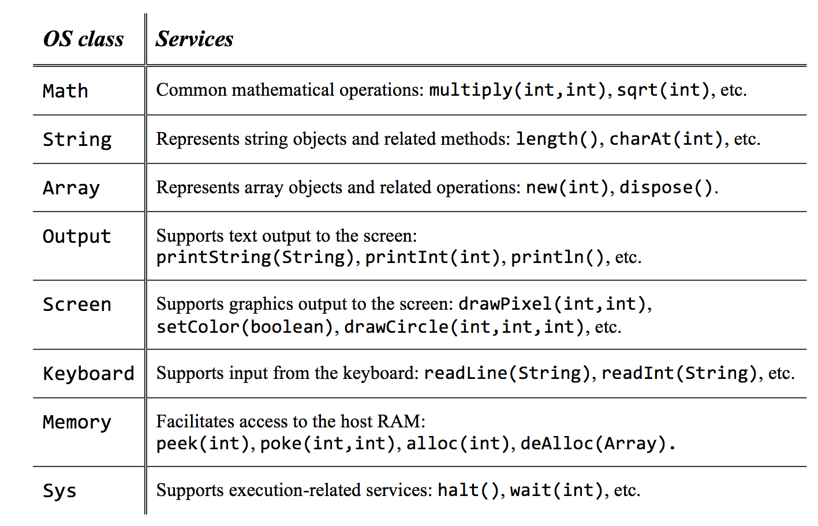
Jack’s standard class library / OS
Complete OS API: Nand2Tetris book / website

Slide 112
High level language: lecture plan
High level programming
Hello world
Procedural programming
Object-based programming
List processing
Application development
Jack applications
Using the OS
Application example
Graphics optimization
Jack language specification
Syntax
Data types
Classes
Methods

Slide 113
Classes
class Foo {
field variable declarations
static variable declarations
subroutine declarations
}

Slide 114
Classes
class Foo {
field variable declarations
static variable declarations
subroutine declarations
}

Slide 115
Subroutines
Subroutine declaration
constructor | method | function type subroutineName (parameter-list) {
local variable declarations
statements
}
Jack subroutines
Constructors: create new objects
Methods: operate on the current object
Functions: static methods
Subroutine types and return values
Method and function type can be either void, a primitive data type, or a class name
Each subroutine must end with return value or return.

Slide 116
Constructors
Constructor declaration
constructor ClassName constructorName (parameter-list) {
local variable declarations
statements
}
Constructors
0, 1, or more in a class
Common name: new
The constructor’s type must be the name of the constructor’s class
The constructor must return a reference to an object of the class type.
class Point {
field int x;
field int y;
...
/* Creates a Point. */
constructor Point new(int ax, int ay) {
let x = ax;
let y = ay;
return this;
}
...
}

Slide 117
Variables
Variable kinds:
field variables: object properties, can be manipulated by the class constructors and methods
static variables: class-level variables, can be manipulated by the class subroutines
local variables: used by subroutines, for local computations
parameter variables: used to pass values to subroutines, behave like local variables
/** Represents a Point object. */
class Point {
field int x, y;
static int pointCount;
...
method int bla(int z) {
int foo;
let foo = z * (x + y);
return foo;
}
...
}
Variables must be ...
Declared before they are used
Typed.

Slide 118
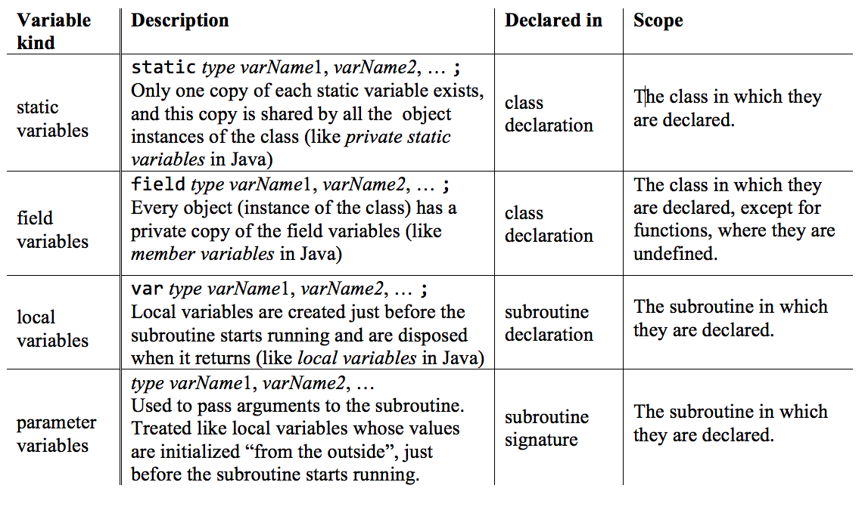
Variables

Slide 119
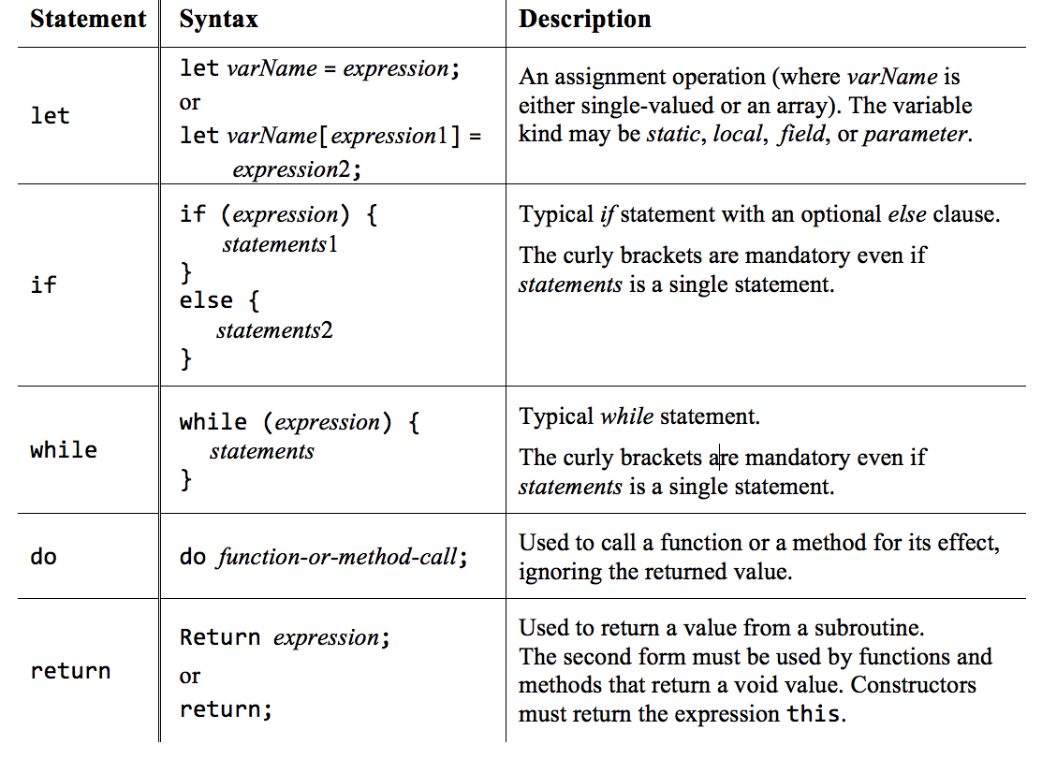
Statements

Slide 120
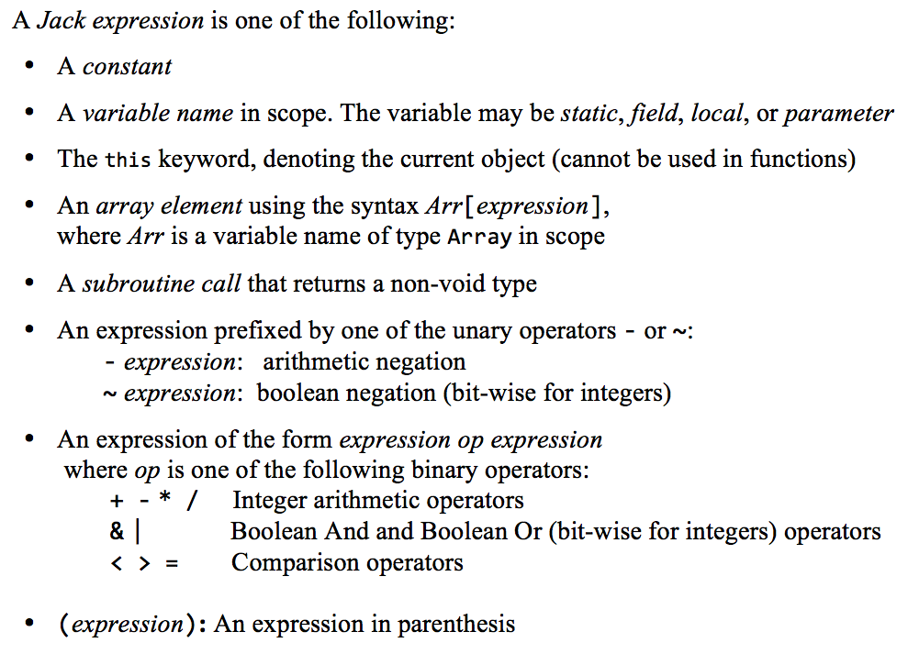
Expressions

Slide 121
Expressions

Slide 122
Expressions

Slide 123
Expressions

Slide 124
Expressions

Slide 125
Subroutine calls
Examples:
class Foo {
...
method void f() {
var Bar b; // declares a local variable of class type Bar
var int i; // declares a local variable of primitive type int
...

Slide 126
Subroutine calls
Examples:
class Foo {
...
method void f() {
var Bar b; // declares a local variable of class type Bar
var int i; // declares a local variable of primitive type int
...
do g(); // calls method g of the current class on this object
do Foo.p(3); // calls function p of the current class
do Bar.h(); // calls function h of class Bar
let b = Bar.r(); // calls function or constructor r of class Bar
do b.q(); // calls method q of class Bar on the b object
let i = w(b.s(), Foo.t()); // calls method w on this object. The arguments are
// the results of calling method s on object b,
// and function or constructor t of class Foo
...
}
}
Subroutine call syntax: subroutineName(argument-list)
The number and type of arguments must agree with those of the subroutine’s parameters
Each argument can be an expression of unlimited complexity.

Slide 127
Strings
Examples:
...
var String s; // Creates an object variable (pointer), initialized to null
var char c; // Creates a primitive variable, initialized to zero

Slide 128
Strings
Examples:
...
var String s; // Creates an object variable (pointer), initialized to null
var char c; // Creates a primitive variable, initialized to zero
...
// Suppose we want s to refer to the string “Hello World!”:
let s = String.new(12);
// Followed by a loop that uses String’s appendChar method to set s to “Hello World!”
// (loop code not shown)
// Alternatively, the Jack compiler allows using:
let s = ”Hello World”; // “syntactic sugar”
// Accessing some character within a string:
let c = s.charAt(6); // Sets c to the numeric value representing ‘W’.
For more String and character operations, see the String class API

Slide 129
Arrays
Examples:
...
var Array arr;
var String helloWorld;
let helloWorld = “Hello World!”
...

Slide 130
Arrays
Examples:
...
var Array arr;
var String helloWorld;
let helloWorld = “Hello World!”
...
let arr = Array.new(4);
let arr[0] = 12;
let arr[1] = false;
let arr[2] = Fraction.new(314/100);
let arr[3] = helloWorld;
...
Jack arrays are ...
instances (objects) of the OS class Array
not typed
uni-dimensional
Multi-dimensional arrays can be obtained by using an arrays of arrays.

Slide 131
End note: peculiar features of the Jack language
The keyword let: must be used in assignments: let x = 0;
The keyword do: must be used for calling a method or a function outside an expression: do reduce();
The body of a statement must be within curly brackets, even if it contains a single statement: if (a > 0) {return a;} else {return –a;}
All subroutine must end with a return
No operator priority:
The following value if unpredictable: 2 + 3 * 4
To enforce priority of operations, use parentheses: 2 + (3 * 4)
The language is weakly typed.
These concessions make the life of the compiler writer much easier.

Slide 132
High level language: lecture plan
High level programming
Hello world
Procedural programming
Object-based programming
List processing
Application development
Jack applications
Using the OS
Application example
Graphics optimization
Jack language specification
Syntax
Data types
Classes
Methods

Slide 133
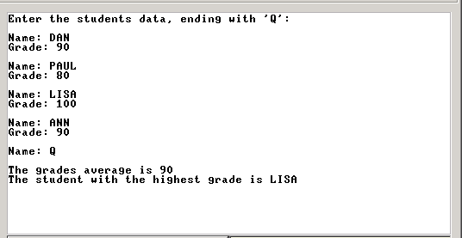
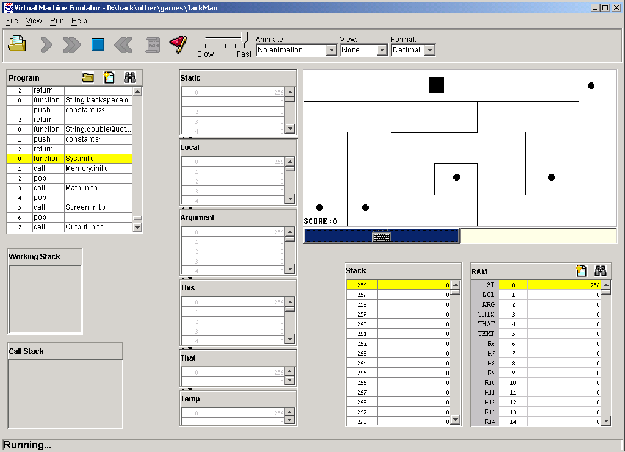
Sample applications: Stats

Slide 134
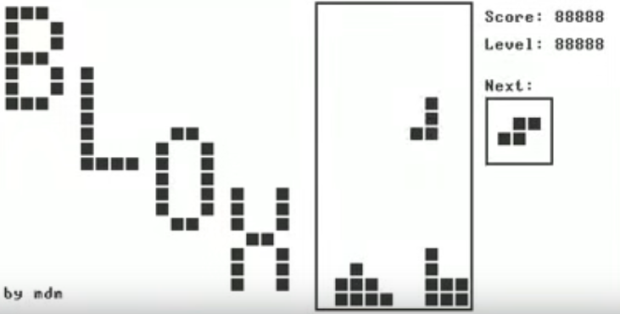
Sample applications: Tetris (by Marc Domink Migge)

Slide 135
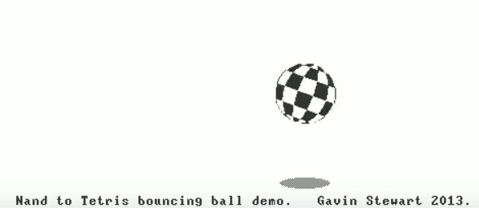
Sample applications: Bouncing Ball (by Gavin Stewart)

Slide 136
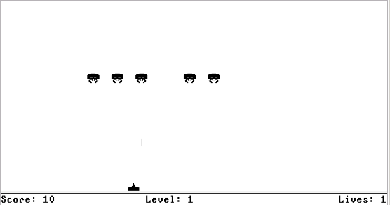
Sample applications: Space Invaders (by Ran Navok)

Slide 137
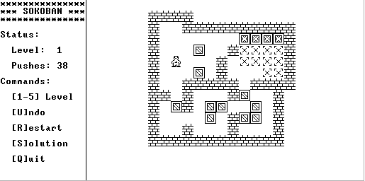
Sample applications: Sokoban (by Golan Parashi)

Slide 138
Developing a Jack application
Put all the app files in one directory, whose name is the app name
Write / edit your Jack class files using a standard text editor
Compile your Jack files / directory using the supplied JackCompiler (available in nand2tetris/tools)
Execute your app by loading the app directory (which now contains the compiled .vm files) into the supplied VM emulator, and running the code

Slide 139
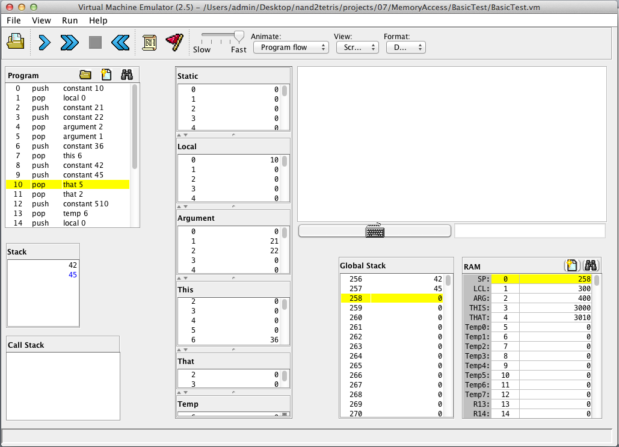
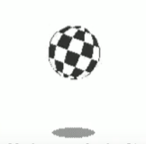
Running a Jack application

Slide 140
High level language: lecture plan
High level programming
Hello world
Procedural programming
Object-based programming
List processing
Application development
Jack applications
Using the OS
Application example
Graphics optimization
Jack language specification
Syntax
Data types
Classes
Methods

Slide 141
Handling output: text
Textual apps:
Screen: 23 rows of 64 characters, b&w
Font: featured by the Jack OS
Output: Jack OS Output class
class Output {
function void moveCursor(int i, int j)
function void printChar(char c)
function void printString(String s)
function void printInt(int i)
function void println()
function void backSpace()
}
OS class, for handling textual output

Slide 142
Handling output: graphics
Graphical apps:
Screen: 256 rows of 512 pixels, b&w
Output: Jack OS Screen class (or do your own)
Class Screen {
function void clearScreen()
function void setColor(boolean b)
function void drawPixel(int x, int y)
function void drawLine(int x1, int y1, int x2, int y2)
function void drawRectangle(int x1, int y1, int x2, int y2)
function void drawCircle(int x, int y, int r)
}
OS class, for handling graphical output

Slide 143
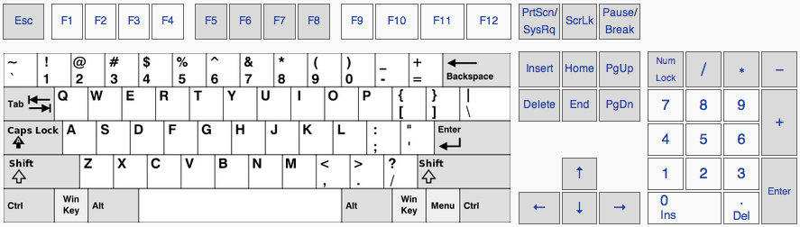
Handling inputs
Input device:
Standard keyboard
Input programming:
use the OS Keyboard class
Class Keyboard {
function char keyPressed()
function char readChar()
function String readLine(String message)
function int readInt(String message)
}
OS class, for handling input from the keyboard

Slide 144
The Jack character set
key | code
(space) | 32
! | 33
“ | 34
# | 35
$ | 36
% | 37
& | 38
‘ | 39
( | 40
) | 41
* | 42
+ | 43
, | 44
- | 45
. | 46
/ | 47
key | code
0 | 48
1 | 49
… | …
9 | 57
key | code
A | 65
B | 66
C | …
… | …
Z | 90
key | code
a | 97
b | 98
c | 99
… | …
z | 122
key | code
newline | 128
backspace | 129
left arrow | 130
up arrow | 131
right arrow | 132
down arrow | 133
home | 134
end | 135
Page up | 136
Page down | 137
insert | 138
delete | 139
esc | 140
f1 | 141
… | …
f12 | 152
: | 58
; | 59
< | 60
= | 61
> | 62
? | 63
@ | 64
[ | 91
/ | 92
] | 93
^ | 94
_ | 95
` | 96
{ | 123
| | 124
} | 125
~ | 126
Keyboard.keypress()
returns the code of the currently pressed key, or 0 when no key is pressed

Slide 145
The Jack OS: Math
class Math {
function void init()
function int abs(int x)
function int multiply(int x, int y)
function int divide(int x, int y)
function int min(int x, int y)
function int max(int x, int y)
function int sqrt(int x)
}

Slide 146
The Jack OS: String
Class String {
constructor String new(int maxLength)
method void dispose()
method int length()
method char charAt(int j)
method void setCharAt(int j, char c)
method String appendChar(char c)
method void eraseLastChar()
method int intValue()
method void setInt(int j)
function char backSpace()
function char doubleQuote()
function char newLine()
}

Slide 147
The Jack OS: Array
Class Array {
function Array new(int size)
method void dispose()
}

Slide 148
The Jack OS: Memory
class Memory {
function int peek(int address)
function void poke(int address, int value)
function Array alloc(int size)
function void deAlloc(Array o)
}

Slide 149
The Jack OS: Sys
Class Sys {
function void halt():
function void error(int errorCode)
function void wait(int duration)
}

Slide 150
Sample Jack programs
Square: a simple, interactive, multi-class OO application
Pong: a complete, interactive, multi-class OO application
Average: illustrates simple array processing
ComplexArrays: illustrates various array manipulations, including two-dimensional arrays
ConvertToBin: illustrates algebraic operations, and working with peek and poke
Code: nand2tetris/projects/11

Slide 151
Best practice
General
Watch some existing Jack programs (see “cool stuff” in www.nand2tetris.org)
Play with the supplied programs, and review their code (e.g. Square and Pong)
Understand the UX limitations of the Jack I/O
Plan your app carefully (OO design and testing strategy)
Implement, test, and ... have fun!
Technical
Writing: Write / edit your Jack class files in a standard text editor; The OS API is supplied in nand2tetris/projects/09
Optimizing: later
Documenting: use standard practice
Compiling: use the supplied JackCompiler (available in nand2tetris/tools)
Executing: load the app directory (which now contains the compiled .vm files) into the supplied VM emulator, and run the code
(remember the emulator’s speed and animation controls).

Slide 152
High level language: lecture plan
High level programming
Hello world
Procedural programming
Object-based programming
List processing
Application development
Jack applications
Using the OS
Application example
Graphics optimization
Jack language specification
Syntax
Data types
Classes
Methods

Slide 153
Objectives
The Square code review illustrates:
OO design
A typical interactive application
Handling inputs and outputs
Using the OS

Slide 154

Demo
Square Dance
demo

Slide 155
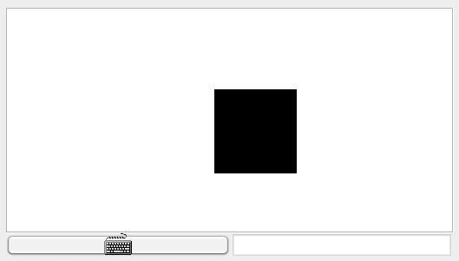
Square Dance game
When the game starts, a black square is displayed at the top left of the screen:
When the game starts, a black square appears at the top left of the screen.
If the square hits a wall, it stays there until some user action frees it.
If the user presses:
up arrow: the square starts moving up, until another key is pressed
down arrow: the square starts moving down, until another key is pressed
left arrow: the square starts moving left, until another key is pressed
right arrow: the square starts moving right, until another key is pressed
x key: the square’s size increases a little (2 pixels)
z key: the square’s size decreases a little (2 pixels)
q: game over.

Slide 156
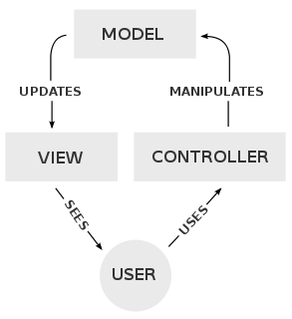
App design
When the game starts, a black square is displayed at the top left of the screen:
When the game starts, a black square appears at the top left of the screen.
MVC model
Three Jack classes:
Square: represents a graphical square
SquareGame: captures user’s inputs and moves the square accordingly (in a loop)
Main: starts the app, initializes the game, and launches it
(source: Wikipedia)

Slide 157
Square class API
Square API
/** Implements a graphical square. */
class Square {

Slide 158
Square class API
Square API
/** Implements a graphical square. */
class Square {
/** Constructs a new square with a given location and size */
constructor Square new(int Ax, int Ay, int Asize)
/** Disposes this square */
method void dispose()
/** Draws this square on the screen */
method void draw()
/** Erases this square from the screen */
method void erase()
/** Increments this square’s size by 2 pixels */
method void incSize()
/** Decrements this square’s size by 2 pixels */
method void decSize()
/** Moves this square up by 2 pixels */
method void moveUp()
/** Moves this square down by 2 pixels */
method void moveDown()
/** Moves this square left by 2 pixels */
method void moveLeft()
/** Moves this square right by 2 pixels */
method void moveRight()
}

Slide 159
Square class
Square.jack
/** Implements a graphical square. */
class Square {

Slide 160
Square class
Square.jack
/** Implements a graphical square. */
class Square {
field int x, y; // screen location of the square's top-left corner
field int size; // length of this square, in pixels
/** Constructs a new square with a given location and size. */
constructor Square new(int Ax, int Ay, int Asize) {
let x = Ax;
let y = Ay;
let size = Asize;
do draw();
return this;
}
/** Disposes this square. */
method void dispose() {
do Memory.deAlloc(this);
return;
}
...
(0,0)
x
y
size

Slide 161
Square class
Square.jack
/** Implements a graphical square. */
class Square {
field int x, y; // screen location of the square's top-left corner
field int size; // length of this square, in pixels
...
/** Draws the square on the screen. */
method void draw() {
do Screen.setColor(true);
do Screen.drawRectangle(x, y, x + size, y + size);
return;
}
/** Erases the square from the screen. */
method void erase() {
(0,0)
x
y
size

Slide 162
Square class
Square.jack
/** Implements a graphical square. */
class Square {
field int x, y; // screen location of the square's top-left corner
field int size; // length of this square, in pixels
...
/** Draws the square on the screen. */
method void draw() {
do Screen.setColor(true);
do Screen.drawRectangle(x, y, x + size, y + size);
return;
}
/** Erases the square from the screen. */
method void erase() {
do Screen.setColor(false);
do Screen.drawRectangle(x, y, x + size, y + size);
return;
}
...
x
y
size

Slide 163
Square class
Square.jack
/** Implements a graphical square. */
class Square {
field int x, y; // screen location of the square's top-left corner
field int size; // length of this square, in pixels
...
/** Increments the square size by 2 pixels. */
method void incSize() {
if (((y + size) < 254) & ((x + size) < 510)) {
do erase();
let size = size + 2;
do draw();
}
return;
}
/** Decrements the square size by 2 pixels. */
method void decSize() {
if (size > 2) {
do erase();
let size = size - 2;
do draw();
}
return;
}
...
...
x
y
size

Slide 164
Square class
Square.jack
/** Implements a graphical square. */
class Square {
field int x, y; // screen location of the square's top-left corner
field int size; // length of this square, in pixels
...
/** Moves the square up by 2 pixels. */
method void moveUp() {
if (y > 1) {
do Screen.setColor(false);
do Screen.drawRectangle(x, (y + size) - 1, x + size, y + size);
let y = y - 2;
do Screen.setColor(true);
do Screen.drawRectangle(x, y, x + size, y + 1);
}
return;
}
method void moveDown() { // similar }
method void moveLeft() { // similar }
method void moveRight() { // similar }
...
} // class Square
x
y
size

Slide 165
SquareGame class
SquareGame.jack
/** Implements a square game. */
class SquareGame {

Slide 166
SquareGame class
SquareGame.jack
/** Implements a square game. */
class SquareGame {
field Square square; // the square of this game
field int direction; // the square’s current direction:
// 0=none, 1=up, 2=down, 3=left, 4=right
/** Constructs a new Square Game. */
constructor SquareGame new() {
let square = Square.new(0, 0, 30);
let direction = 0;
return this;
}
/** Disposes this game. */
method void dispose() {
do square.dispose();
do Memory.deAlloc(this);
return;
}
...

Slide 167
SquareGame class
SquareGame.jack
/** Implements a square game. */
class SquareGame {
field Square square; // the square of this game
field int direction; // the square’s current direction:
// 0=none, 1=up, 2=down, 3=left, 4=right
/** Moves the square in the current direction. */
method void moveSquare() {
if (direction = 1) { do square.moveUp(); }
if (direction = 2) { do square.moveDown(); }
if (direction = 3) { do square.moveLeft(); }
if (direction = 4) { do square.moveRight(); }
do Sys.wait(5); // delays the next movement
return;
}
...

Slide 168
SquareGame class
SquareGame.jack
/** Implements a square game. */
class SquareGame {
field Square square; // the square of this game
field int direction; // the square’s current direction:
// 0=none, 1=up, 2=down, 3=left, 4=right
/** Runs the game: handles the user’s inputs and moves the square accordingly */
method void run() {
var char key; // the key currently pressed by the user
var boolean exit;
let exit = false;
while (~exit) {
// waits for a key to be pressed
while (key = 0) {
let key = Keyboard.keyPressed();
do moveSquare();
}
if (key = 81) { let exit = true; } // q key
if (key = 90) { do square.decSize(); } // z key
if (key = 88) { do square.incSize(); } // x key
if (key = 131) { let direction = 1; } // up arrow
if (key = 133) { let direction = 2; } // down arrow
if (key = 130) { let direction = 3; } // left arrow
if (key = 132) { let direction = 4; } // right arrow
// waits for the key to be released
while (~(key = 0)) {
let key = Keyboard.keyPressed();
do moveSquare();
}
} // while
return;
}
} // SquareGame class
typical handling of “keyboard events” in interactive Jack apps

Slide 169
Main class
Main.jack
/**
* Main class of the Square Dance game.
*/
class Main {

Slide 170
Main class
Main.jack
/**
* Main class of the Square Dance game.
*/
class Main {
/** Initializes a new game and starts it. */
function void main() {
var SquareGame game;
let game = SquareGame.new();
do game.run();
do game.dispose();
return;
}
}

Slide 171
Recap
Important issues:
Understanding the UI style
Getting to know the Jack OS
OO design
Testing stratgey

Slide 172
High level language: lecture plan
High level programming
Hello world
Procedural programming
Object-based programming
List processing
Application development
Jack applications
Using the OS
Application example
Graphics optimization
Jack language specification
Syntax
Data types
Classes
Methods

Slide 173
Square dance

Slide 174
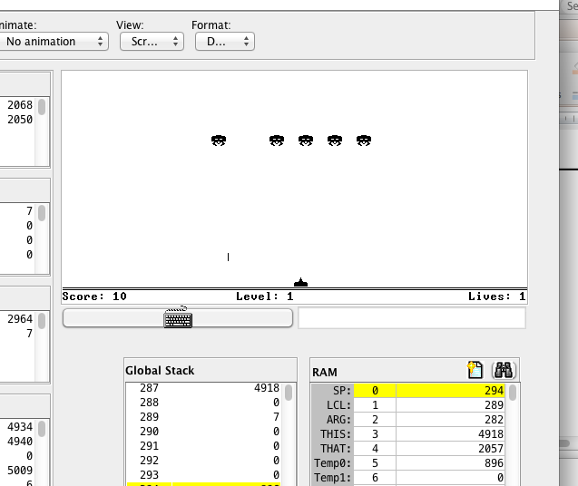
Space Invaders (by Ran Navok)

Slide 175
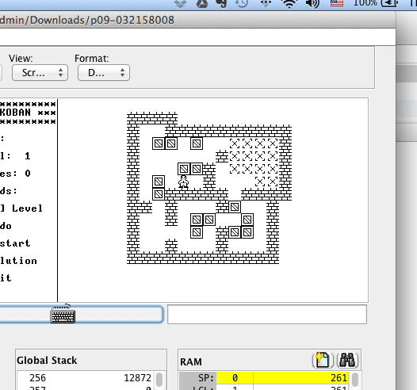
Sokoban (by Golan Parashi)

Slide 176
Handling sprites
Sprite
A two-dimensional bitmap, typically integrated into a larger scene
Challenges
Drawing sprites quickly
Creating smooth animations
Solutions
Use the standard OS graphics library
Use your own graphics functions

Slide 177
Hack I/O
Hack RAM
0
1
2
...
32767
0001100000100100
1111000010100001
...
...
1000111100111100

Slide 178


Hack I/O
Hack RAM
0
1
2
...
...
16384
...
...
24575
24576
...
32767
0001100000100100
1111000010100001
...
...
...
1000111100111100
8K screen
memory map
refresh
1 word kb map

Slide 179
Memory map
Hack RAM
0
1
2
...
...
16384
...
19003
...
24575
...
...
32767
0001100000100100
1111000010100001
...
...
0000000000000000
...
0000000000000000
...
0000000000000000
...
...
1000111100111100
0 1 2 ... 511
0
1
...
255
refresh
8K screen
memory map
Hack screen:
256 rows by 512 columns

Slide 180
Memory map
Hack RAM
0
1
2
...
...
16384
...
19003
...
24575
...
...
32767
0001100000100100
1111000010100001
...
...
0000000000000000
...
0000000000000111
...
0000000000000000
...
...
1000111100111100
0 1 2 ... 511
0
1
...
255
refresh
...
8K screen
memory map
Hack screen:
256 rows by 512 columns

Slide 181
Memory map
Hack RAM
0
1
2
...
...
16384
...
19003
...
24575
...
...
32767
0001100000100100
1111000010100001
...
...
0000000000000000
...
1111111111111111
...
0000000000000000
...
...
1000111100111100
0 1 2 ... 511
0
1
...
255
refresh
................
8K screen
memory map
Hack screen:
256 rows by 512 columns

Slide 182
Accessing memory: read / write
Hack RAM
The OS Memory class API
0
1
2
...
...
16384
...
19003
...
24575
...
...
32767
0001100000100100
1111000010100001
...
...
0000000000000000
...
0000000000000111
...
0000000000000000
...
...
1000111100111100
function int peek(int address)
function void poke(int address, int value)
...
Jack code
let x = Memory.peek(19003)
// x will be set to 7
do Memory.poke(19003,-1)
// RAM[19003] will be set to
// 1111111111111111

Slide 183
Drawing pixels
Jack code
0 1 2 ... 511
410
// draws the image
do Screen.drawPixel(410,155);
do Screen.drawPixel(411,155);
do Screen.drawPixel(412,155);
do Screen.drawPixel(410,156);
do Screen.drawPixel(411,156);
do Screen.drawPixel(412,156);
0
1
...
255
...
...
155
The OS Screen class API:
function void setColor(boolean b)
function void drawPixel(int x, int y)
function void drawLine(int x1, int y1, int x2, int y2)
function void drawRectangle(int x1, int y1, int x2, int y2)
function void drawCircle(int x, int y, int r):

Slide 184
Drawing pixels
Jack code
0 1 2 ... 511
410
// draws the image
do Screen.drawPixel(410,155);
do Screen.drawPixel(411,155);
do Screen.drawPixel(412,155);
do Screen.drawPixel(410,156);
do Screen.drawPixel(411,156);
do Screen.drawPixel(412,156);
0
1
...
255
...
...
155
// draws the image
do Screen.drawLine(410,155,412,155);
do Screen.drawLine(410,156,412,156);
// draws the image
do Screen.drawRectangle(410,155,412,156);

Slide 185
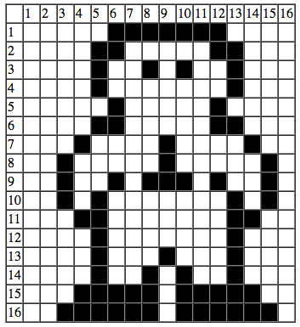
Standard drawing
Image drawing code:

Slide 186
Standard drawing
Image drawing code:
// Draws the top row
do Screen.drawPixel(6,1);
do Screen.drawPixel(7,1);
...
do Screen.drawPixel(12,1);
...
// Draws the bottom row
do Screen.drawPixel(3,16);
...
do Screen.drawPixel(15,16);
Efficiency:
75 pixel drawing operations
OS implementation of drawPixel(x,y)
// sets pixel (x,y) to black / white:
address = 32 * y + x / 16
value = Memory.peek[16384 + address]
set the (x % 16)th bit of value to 0 or 1
do Memory.poke(address,value)
Notes:
40 * 75 = 3000

Slide 187
Custom drawing
0000111111100000
0001100000110000
0001001010010000
...
...
0111111011111100

Slide 188
Custom drawing
0000111111100000 = 4064
0001100000110000 = 6192
0001001010010000 = 4752
...
...
0111111011111100 = 32508

Slide 189
Custom drawing
Image drawing code:
4064
6192
4752
...
...
32508
// Draws the sprite
do Memory.poke(addr0, 4064);
do Memory.poke(addr1, 6192);
do Memory.poke(addr2, 4752);
...
do Memory.poke(addr15,32508);
Efficiency:
16 memory write operations
Notes:
3000 / 30 = 100 times faster

Slide 190
Custom drawing
0 1 2 ... 512
0
1
...
256
row 0

Slide 191
Custom drawing
Hack RAM
0 1 2 ... 512
0
1
2
..
...
16384
...
...
24575
...
...
32767
0001100000100100
1111000010100001
...
...
0000000000000000
...
...
0000000000000000
...
...
1000111100111100
0
1
...
256
refresh
8K screen
memory map

Slide 192
Custom drawing
screen memory map
0 1 2 ... 512
410
0
1
2
...
8191
0000000000000000
...
...
0000000000000000
0
1
...
256
8K screen
memory map
155

Slide 193
Custom drawing
screen memory map
0 1 2 ... 512
410
0
..
31
32
..
63
..
...
addr
...
...
addr + 32
...
...
addr + 64
...
...
...
addr + 480
...
8191
0000000000000000
...
0000000000000000
0000000000000000
...
0000000000000000
...
...
0000011111110000
...
...
0000110000011000
...
...
0000100101001000
...
...
...
0111111011111100
...
...
0000000000000000
...
0000000000000000
0
1
...
256
row 0
row 1
155
row 155
row 156
Image drawing code:
// Draws the sprite
do Memory.poke(addr + 0, 4064);
do Memory.poke(addr + 32, 6192);
do Memory.poke(addr + 64, 4752);
...
do Memory.poke(addr + 480, 32508);
row 157
row 170
...
Absolute addressing
Add (16384 + location) to addr
row 256

Slide 194
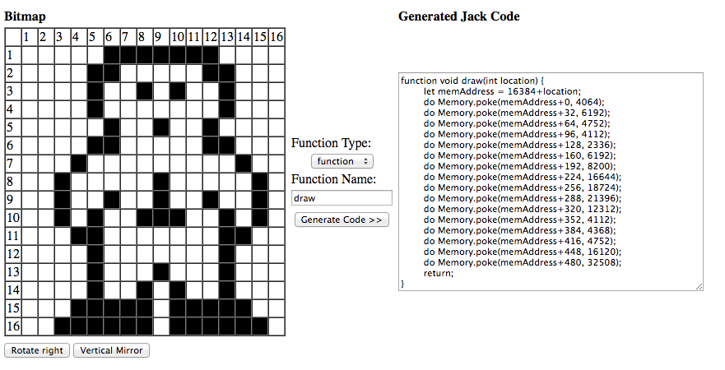
Bitmap editor
Developed by Golan Parashi
Available in nand2tetris/projects/09

Slide 195
Best practice
For simple graphics, use the OS services
For high-performance graphics, use your own functions
If you need high-performance sprites, use the bitmap editor:
Design the sprite
Generate the Jack code
Plant the generated Jack code in your own Jack code

Slide 196
Perspective
Jack is a nice little language,
Featuring most of the essentual elements of
procedural
OO programming
Limitations
Few control structures
Some peculiar syntax
No inheritance
Motivation: a minimal language that can be implemented by a simple compiler
Data types
Primitive type system
Weakly typed
Motivation: to give the programmer full control, especially for writing the OS.

